Slide 1
TICKET BOOKING APPLICATION
INTRODUCTION

Slide 2
What is Ticket Booking application all about?
The Ticket Booking System presents a streamlined solution for travelers to efficiently book train tickets and for administrators to manage train schedules and bookings. With its intuitive interface and comprehensive functionalities, this project consists of two modules aimed at simplifying the train booking process. Administrators play a pivotal role in the system, with the ability to register and log in, subsequently adding locations and scheduling trains with ease. By selecting source and destination locations and specifying dates, times, and fare prices, administrators ensure a seamless booking experience for customers.

Slide 3
PROJECT SCOPE
The Ticket Booking System encompasses a wide-ranging scope aimed at revolutionizing the train ticketing process and enhancing the overall experience for both administrators and travelers. At its core, the system provides administrators with a robust platform to register, log in, and manage various aspects of train operations. This includes the addition of new locations, scheduling trains, and monitoring ticket bookings, ensuring comprehensive control over the entire booking process.

Slide 4
AIMS & OBJECTIVES
Optimization of Ticketing Process
Promotion of Transparency and Accessibility
Empowerment through Data-Driven Insights

Slide 5
OVERALL DESCRIPTION
The Booking System (TTBS) revolutionizes the process of booking train tickets by providing a centralized platform for administrators and travelers. Administrators can efficiently manage schedules, ticket bookings, and customer information, ensuring a seamless experience. With real-time access to train schedules and ticket availability, travelers can make informed decisions, enhancing the overall efficiency and convenience of the booking process.

Slide 6
BENEFITS OF TRAIN TICKET BOOKING SYSTEM
This Ticketing System solution is fully functional and flexible.
It is very easy to use.
This online system helps in back-office administration by streamlining and standardizing the procedures.
It saves a lot of time, because of remote access.
The application acts as an office that is open 24/7.
It increases the efficiency of the management at offering quality services to the customers.

Slide 7
USERS AND CHARACTERISTICS
Admin
Admin can register and login.
Admin can add the Locations, Train & Train Seats.
Admin can update and delete the Trains.
Admin can View all Trains.
Admin can schedule the Trains.
Admin can update the scheduled trains.
Admin can view Train Tickets Bookings.

Slide 8
USERS AND CHARACTERISTICS
Manager
Customer can register & login.
Customer can view the scheduled trains.
Customer can search the scheduled Trains.
Customer can view Train Seats availability.
Customer can Book the Train by selecting the seats.
Customer can cancel the Train Seat.

Slide 9
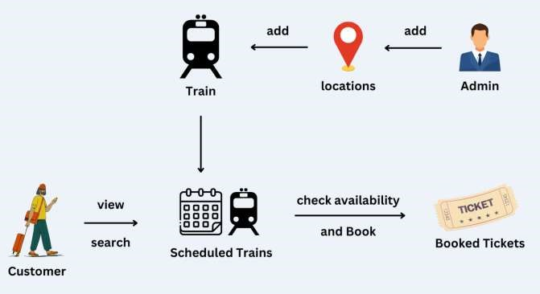
PROJECT FLOW

Slide 10
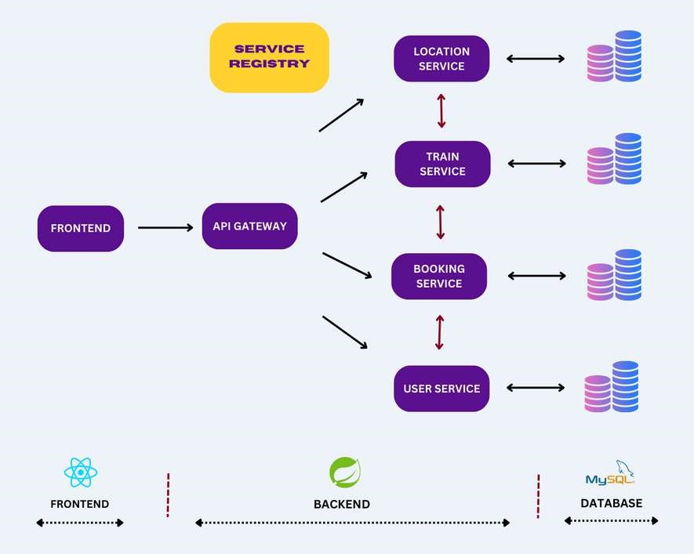
MICRO SERVICES STRUCTURE

Slide 11
API Gateway Service
An API Gateway is a component that acts as a single entry point for client applications to interact with various micro services within the system.
Service Registry Service
A Service Registry is a component that facilitates service discovery and allows micro services to locate and communicate with each other dynamically.
User Service
The User Service will handle all the User-related Operations like user register, login, etc.
Train Service
The Train micro service will handle Trains, Train Seats & Train Scheduling related operations.
Location Service
The Location micro service will handle Train location-related operations.

Slide 12
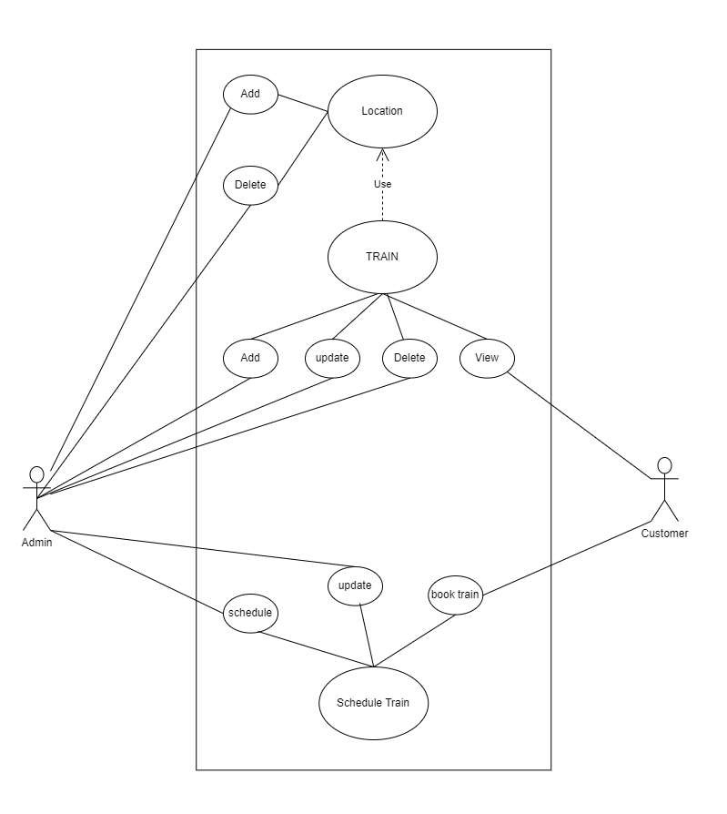
USE CASE DIAGRAM

Slide 13
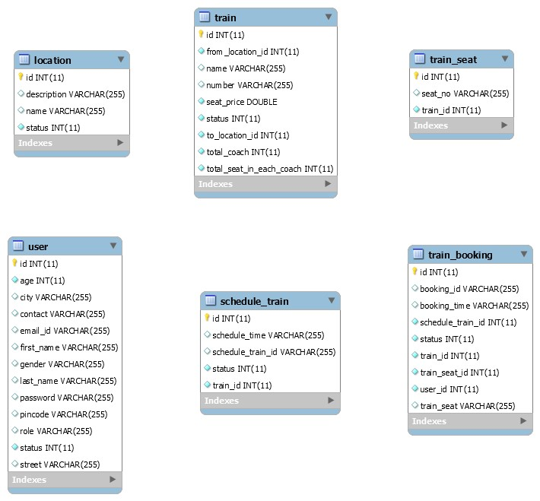
ENTITY RELATIONSHIP DIAGRAM (ER Diagram)

Slide 14
TESTING
Testing is a crucial process in software development that identifies errors and measures quality. It involves executing the program with test cases to ensure it performs as expected. Testing verifies the program's correctness, completeness, and quality, aiding maintenance. Adhering to testing standards reduces costs and time. Extending throughout the coding phase, testing reviews configuration, design, and coding, determining the software's stability. Comprehensive testing of all components prevents bugs post-deployment.

Slide 15
FUTURE ENHANCEMENT
Looking ahead, future enhancements for the Train Ticket Booking System (TTBS) could focus on leveraging emerging technologies to further improve efficiency and enhance the user experience. One potential enhancement could involve the integration of artificial intelligence (AI) and machine learning algorithms to provide personalized recommendations and predictive insights to travelers. By analyzing past booking patterns and user preferences, the TTBS could offer tailored suggestions for train routes, seating options, and travel packages, enhancing the overall booking experience and increasing customer satisfaction.

Slide 16
CHALLENGES
project management
Coordinating a multidisciplinary team of developers, designers, and marketers to keep the project on track.
Continuous Improvement
Regularly updating the app to fix bugs, improve features, and keep up with changing user needs and Technology advancements.
Cost Managements
Managing development and operational costs to stay within the budget.

Slide 17
CHALLENGES
User experience
Designing a user-friendly interface that accommodates both bus ticket booking and car rentals without overwhelming the User
Payment Issues
Integrating payment gateways to support different currencies and payment methods
Handling complex scenarios involving refunds, cancellations and rescheduling

Slide 18
NAMES OF GROUP MEMBERS
SHUYE ANITA BERINYU
ICTU20223188
AMADINE LENYONGA BAMBOT
ICTU20223006
NJIANGA AYOUBA
ICTU20222964
SEIGNOU MBI CHRISTIAN CYRIL
ICTU20223506

Slide 19
NAMES OF GROUP MEMBERS
MVOGONKA CHRISTOPHE
ICTU20222936
MOHAMADOU AWAL
ICTU20223103
NOUMBISSI NGUEYO SAMUEL BRYAN
ICTU20223023
NJANZOU MBOUEMBOUE RAHMA
ICTU20223110
NGUTI KHYEIN
ICTU20233610

